Slide 1
Implementation Part Presentation of chosen theses for CSE 596 course. Part 2(Analysis)
Theses- Using PLM(Pretrained Language Models) for Toxic Comment Classification
Group 5
Members-
Md. Sayadul Hoque (2235106650)
Moinul Hasan Sifat(2235015650)
Bristy Cathrin(2235366650)
Muntaka Sayef(2235082650)

Slide 2
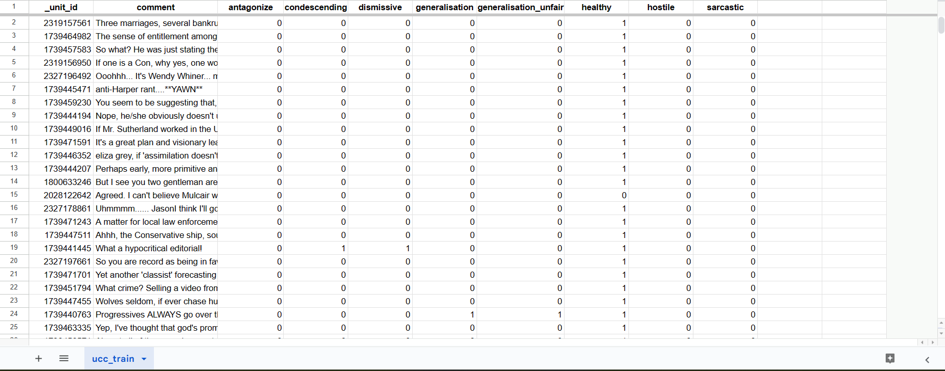
Training Dataset 1(UCC)

Slide 3
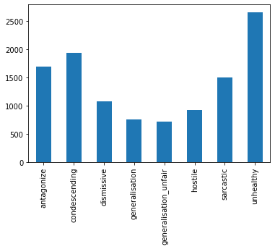
Training Data 1(UCC) Inspection Total row- 35504(Almost 35.5 K)

Slide 4
Attributes & its meaning regrading unhealthy comment
Antagonize: cause (someone) to become hostile or angry.
Condescending: having or showing an attitude of patronizing superiority.
Dismissive: rejecting someone or something.
Generalisation: the action of generalizing.
Generalisation_unfair: not fair category.
Hostile: showing or feeling opposition or dislike.
Sarcastic: marked by or given to using irony in order to mock or convey.
Unhealthy: not good for health.

Slide 5
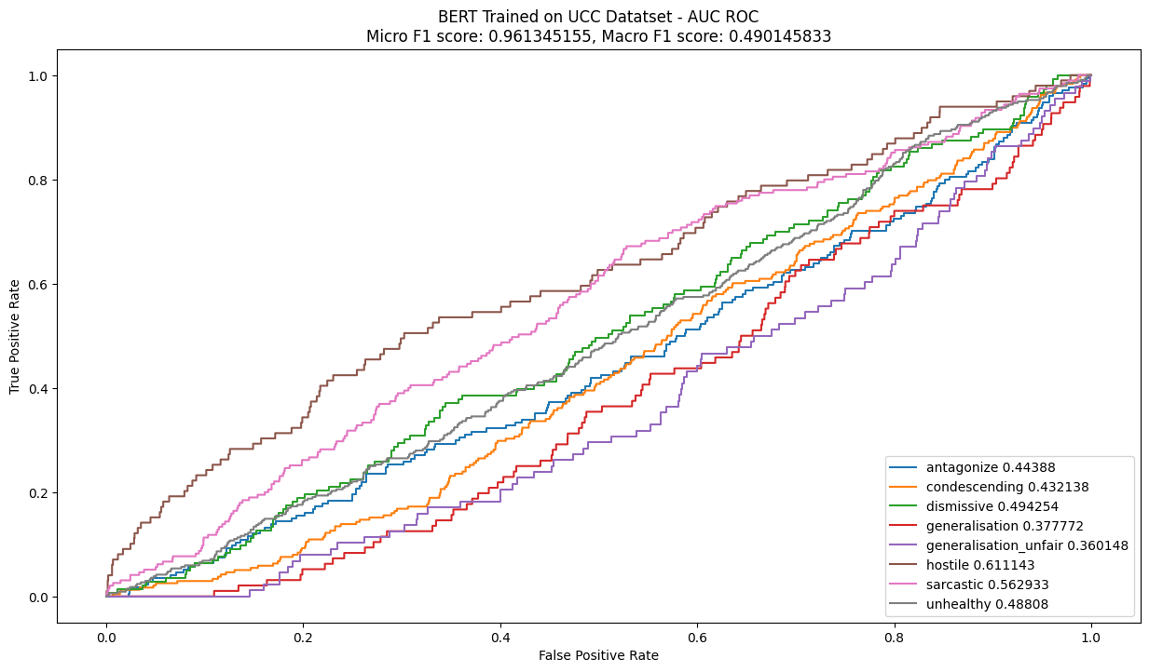
Using BERT for Toxic Comment Classification (UCC dataset) Epoch-1,batch size-64

Slide 6
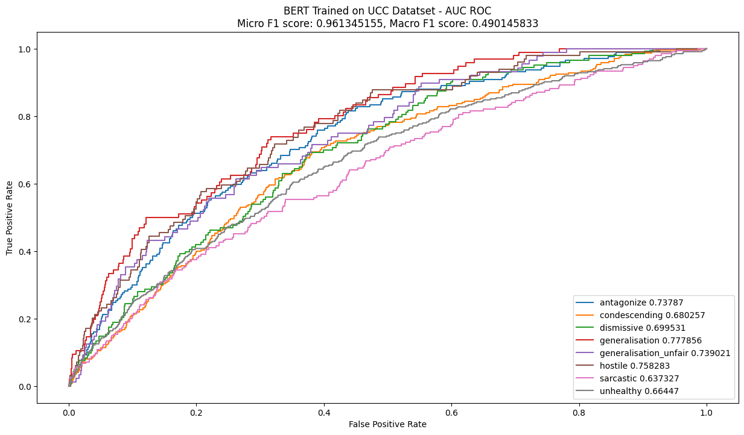
Using BERT for Toxic Comment Classification (UCC dataset) Epoch-5,batch size-64

Slide 7
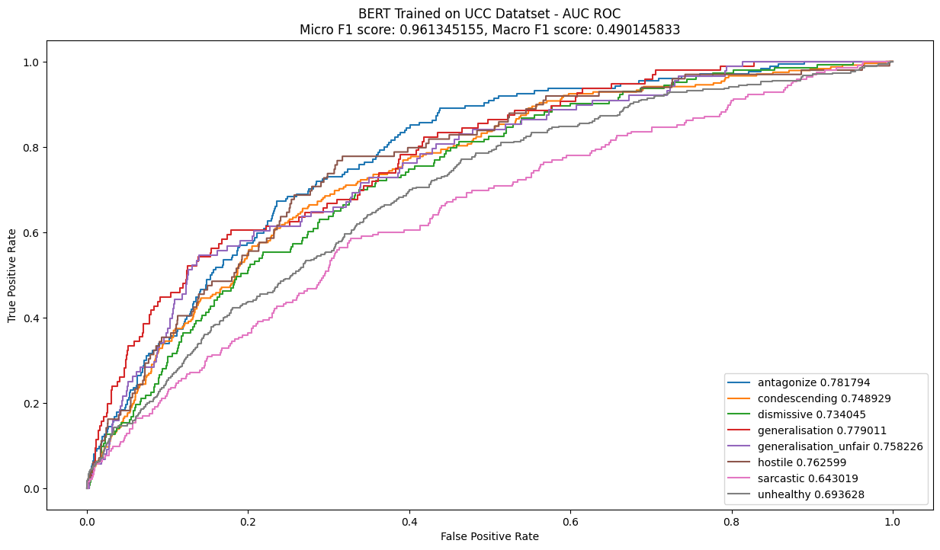
Using BERT for Toxic Comment Classification (UCC dataset) Epoch-10,batch size-64

Slide 8
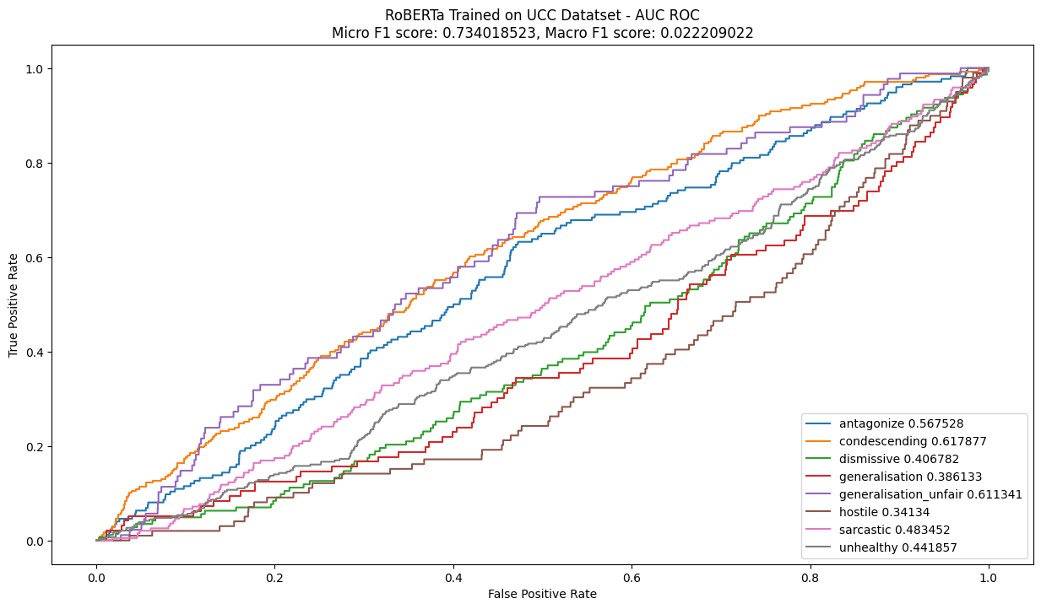
Using RoBERTa for Toxic Comment Classification (UCC dataset) Epoch-1,batch size-64

Slide 9
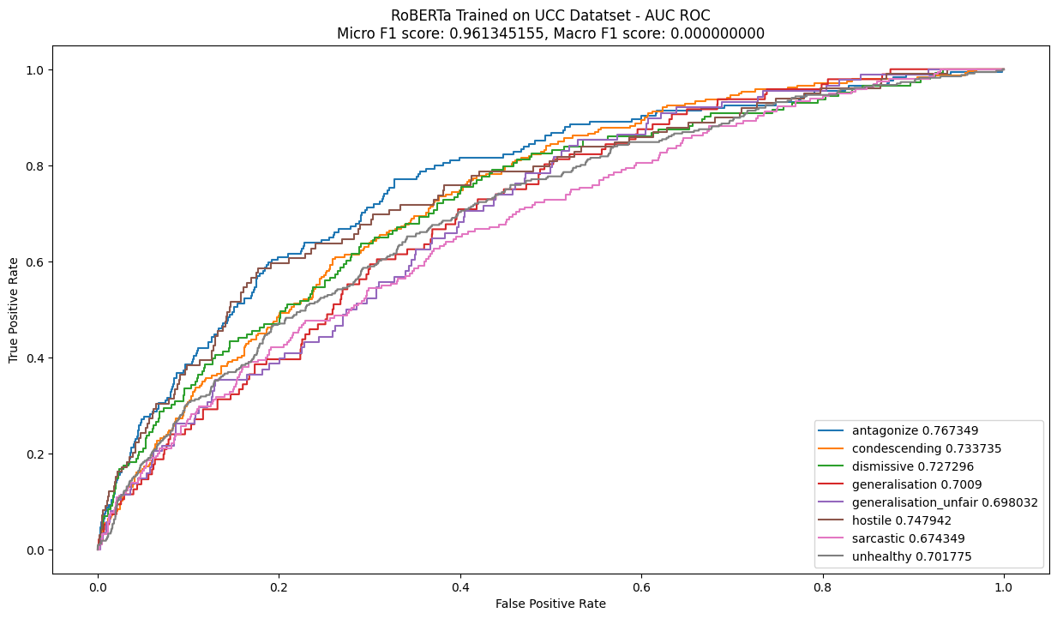
Using RoBERTa for Toxic Comment Classification (UCC dataset) Epoch-5,batch size-64

Slide 10
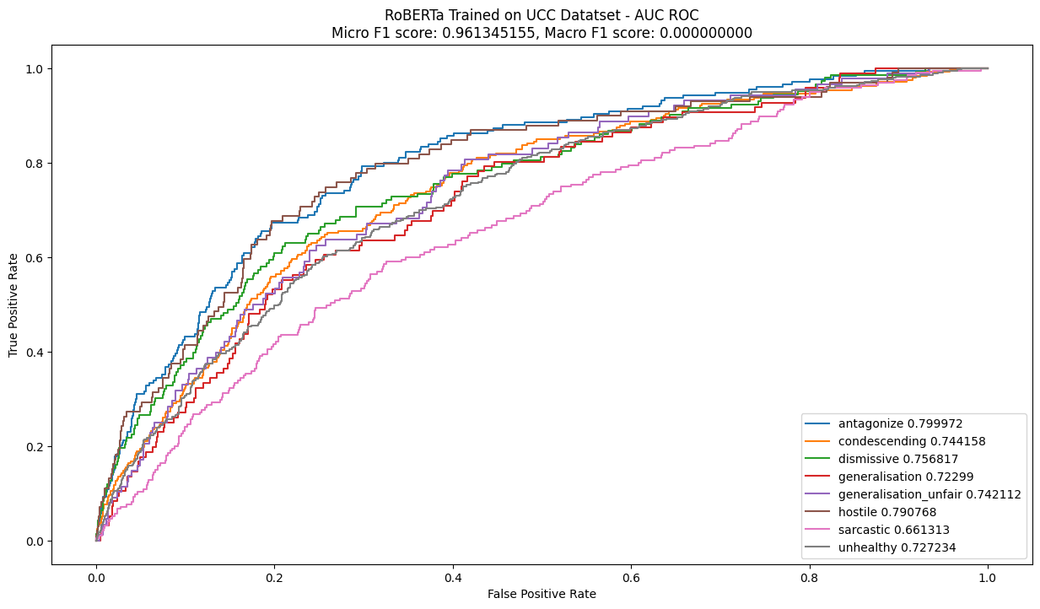
Using RoBERTa for Toxic Comment Classification (UCC dataset) Epoch-10,batch size-64

Slide 11
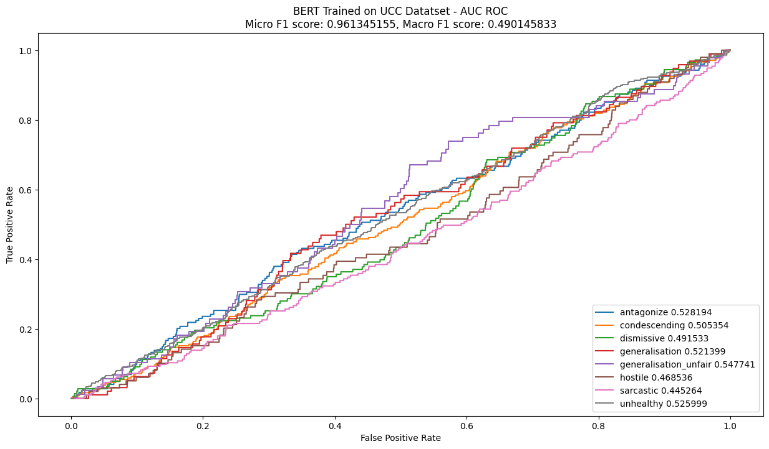
Using XLM for Toxic Comment Classification (UCC dataset) Epoch-1,batch size-64

Slide 12
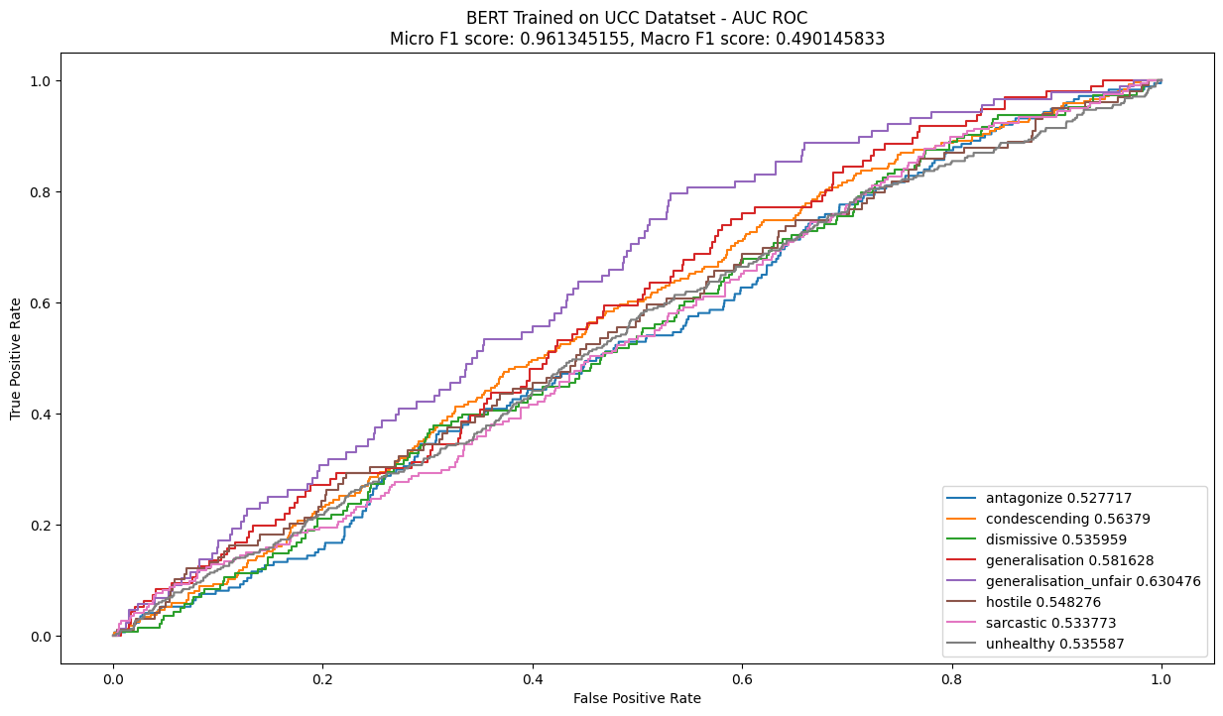
Using XLM for Toxic Comment Classification (UCC dataset) Epoch-5,batch size-64

Slide 13
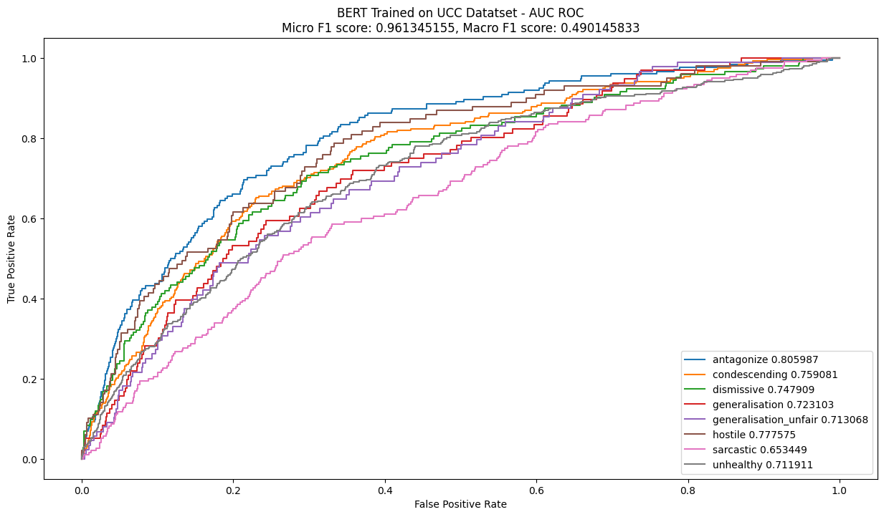
Using XLM for Toxic Comment Classification (UCC dataset) Epoch-10,batch size-64

Slide 14
Thank You.

